Slide 1
Ash Winter
Short stuff here:
@northern_tester
Long stuff here:
testingisbelieving.blogspot.co.uk

Slide 2
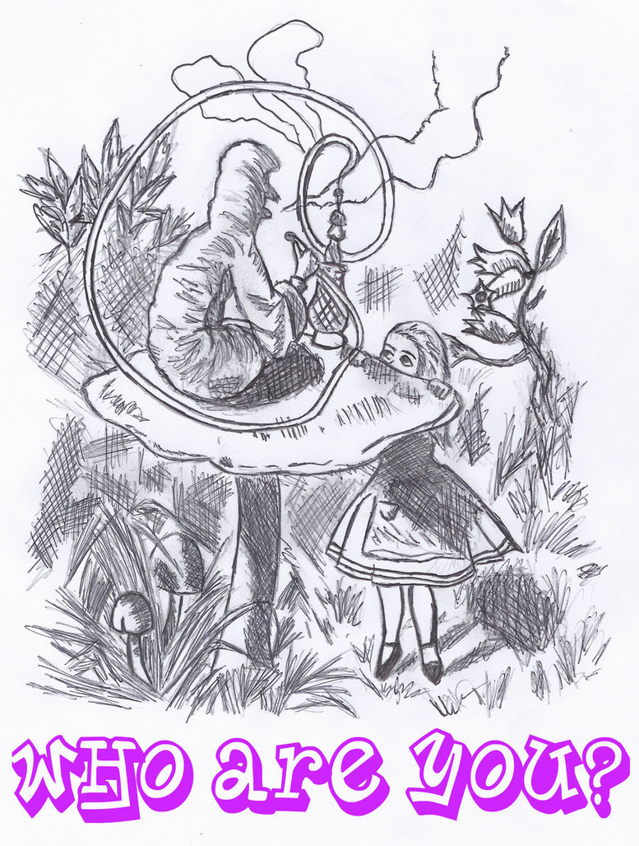
That’s me, what about you?
Pair up!
Three questions:
What’s your name?
How did you get started in testing?
What is the one thing you love most about testing?
Introduce your partner!

Slide 3
Testing the Bigger Picture: System Architecture

Slide 4
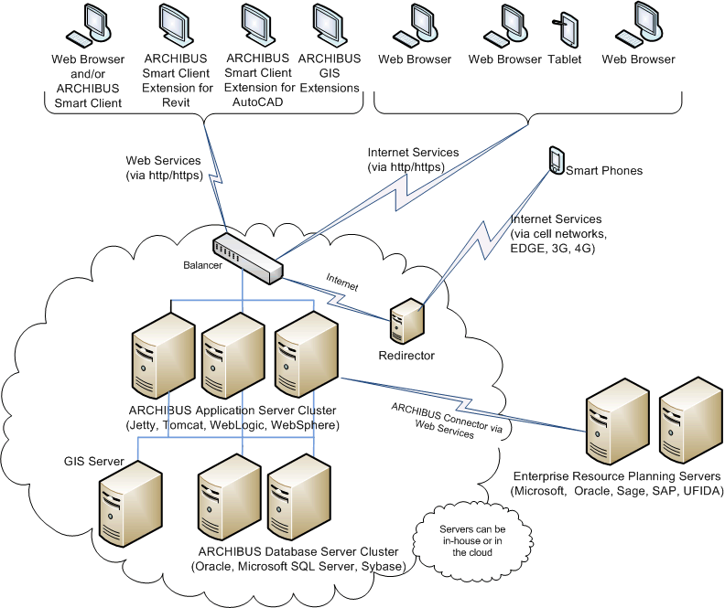
What do I mean by ‘system architecture’…?
Social, abstract construct
Shared understanding of:
Consumers
Components
Interactions
Layers
Fallible – no one model understood commonly by all stakeholders!

Slide 5

Important for testers…
Understand & Contribute!
Ticket by Ticket Syndrome
Avoid Scale Panic
Identify Risk
(Maybe) Enhance Testability

Slide 6

Follow the path…
Recognise – Visual Dictionary (30-40 minutes)
Understand – Puzzle (40-50 minutes)
Apply – The Big Picture (40-50 minutes)

Slide 7

Exercises
Groups!
Kolb!
Visible!
Questions!
Breaks!

Slide 8

Begin!

